Slide 1

Project Title -Seasonal Agriculture Performance Data Analysis
Student Name: Afnan M Khatib
College Name: KARNATAKA STATE OPEN UNIVERSITY, Mysore
AICTE STU ID : (STU6a089c4f40d4f1778949199)

Slide 2

PROBLEM STATEMENT
Agriculture performance changes across different seasons due to variations in rainfall, temperature, soil conditions, irrigation, crop types, and farming practices.
This project analyzes agricultural data to understand seasonal differences, identify patterns and trends, and compare crop performance, production, cost, revenue, and profit.

Slide 3
Project Description
This project analyzes seasonal agriculture data using Python.
The dataset contains information about crops, seasons, farm areas, rainfall, temperature, soil conditions, irrigation, production, costs, revenue, and profit.
The analysis uses Pandas, NumPy, Matplotlib, and Seaborn to identify seasonal patterns and compare agricultural performance.

Slide 4

WHO ARE THE END USERS?
Farmers – to understand crop performance and improve farming decisions.
Agricultural Officers – to study seasonal agricultural patterns and performance.
Agricultural Researchers – to analyze trends and relationships in agricultural data.
Agribusinesses – to understand production, cost, revenue, and profit patterns.

Slide 5

Technology Used
Python – Programming and analysis
Pandas – Data cleaning and analysis
NumPy – Numerical calculations
Matplotlib – Data visualization
Seaborn – Statistical visualization
  Google Colab – Project development environment

Slide 6
Key Results
Analyzed 4,000 agricultural records.
Compared agricultural performance across 3 seasons.
Studied crop-wise yield and production.
Compared cost, revenue, and profit.
Analyzed the relationship between rainfall, temperature, irrigation, and yield.
Identified important seasonal patterns and variations.

Slide 7
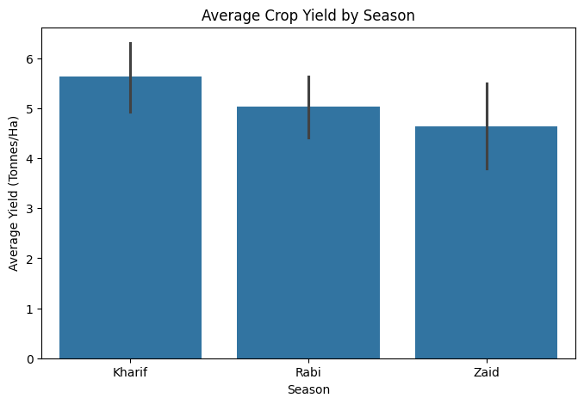
RESULTS
Finding: Crop yield varies across seasons, showing that seasonal conditions influence agricultural performance.

Slide 8
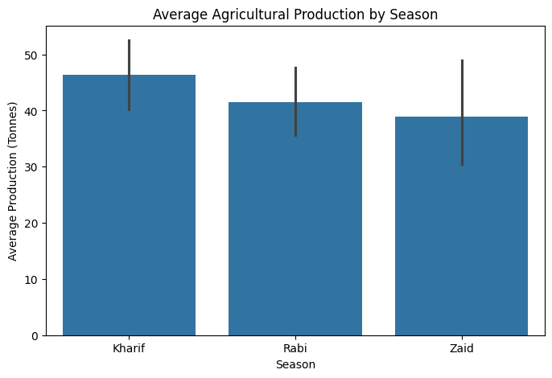
RESULTS
Finding: Average agricultural production differs across seasons.

Slide 9
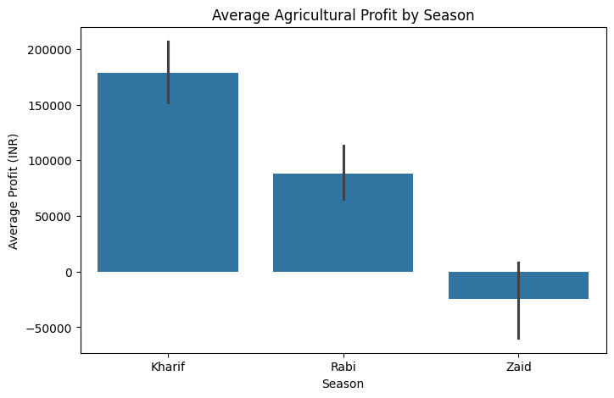
RESULTS
Finding: Profitability changes across seasons due to differences in production, revenue, and costs.

Slide 10
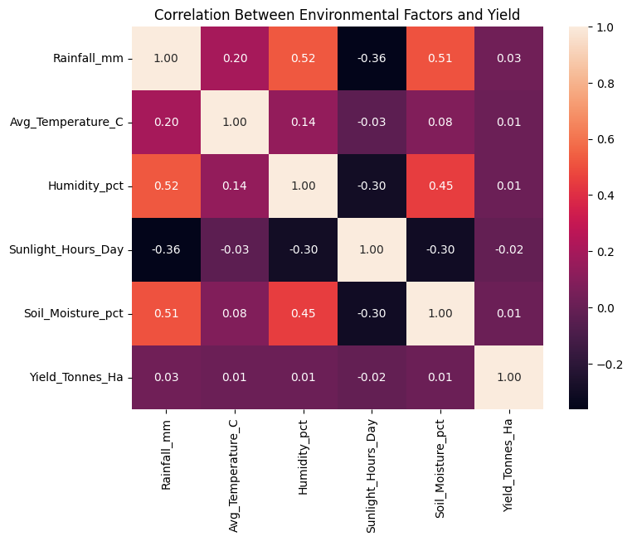
RESULTS
Finding: The correlation analysis shows how environmental factors are related to crop yield.

Slide 11
Future scope
Analyze more agricultural data from different regions and years.
Include additional environmental and economic factors.
Develop interactive dashboards for easier decision-making.
Use advanced analytics to improve agricultural planning.

Slide 12
GitHub Link
https://github.com/afnanmkhatib36-02/Seasonal-Agriculture-Performance-Data-Anaylsis.git

Slide 13

VOIS Course completion certificate -
Course name- Data Visualization

Slide 14
Thank you
.
.

